Slide 1
Lecture №6
Prepared by Norkin Mark Prokofiev Michael

Slide 2
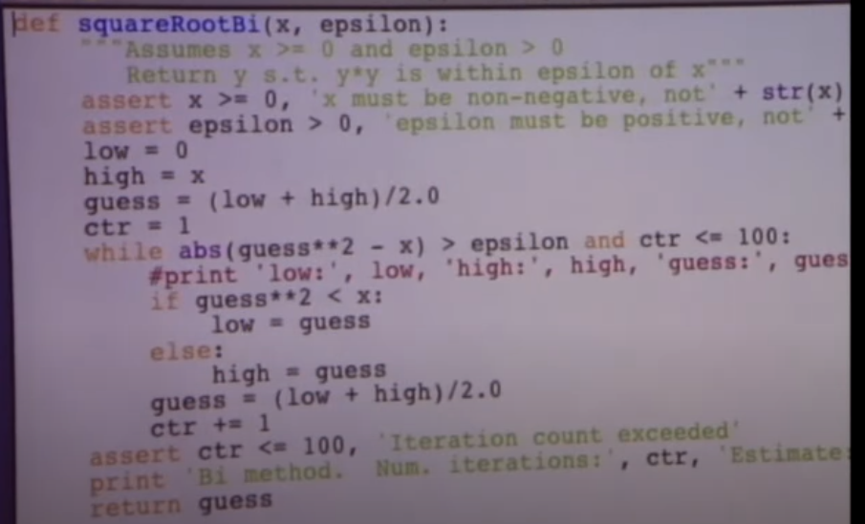
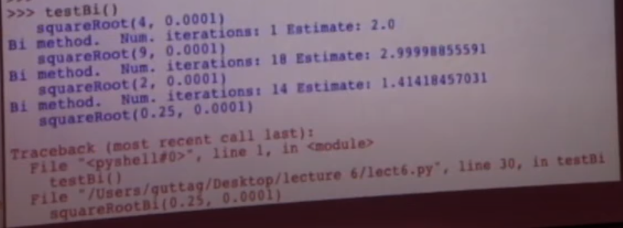
Bisection method bug

Slide 3
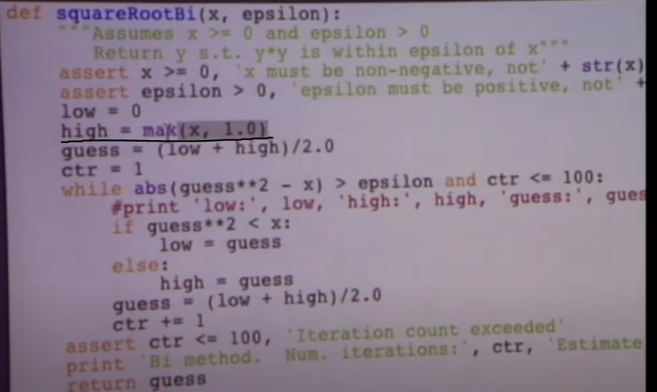
Fixing a bug

Slide 4
Newton’s method
f(guess)= guess² – x
f(guess)=0
To find the root of this equation, you can choose a guess according to the following rule
guess_{i+1} = guess_{i} - f(guess_{i})/(2* guess_{i})

Slide 5
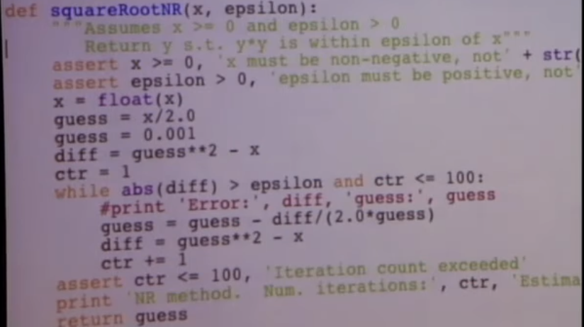
Implementation

